Slide 1
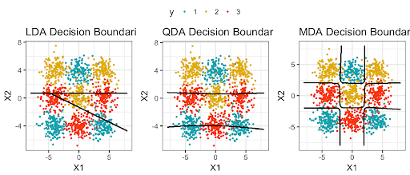

Quadratic Discriminant Analysis (QDA)
By: Ridwan Olawin

Slide 2

Problem Definition
Linear regression assumes the response variable (class label) is quantitative
Predict data with the response variable being qualitative (e.g. binary)
Logistic Regression
Un-stable with small data set
Not the best for multi-classification
LDA
Works better for small data sets
Higher bias and lower variance

Slide 3
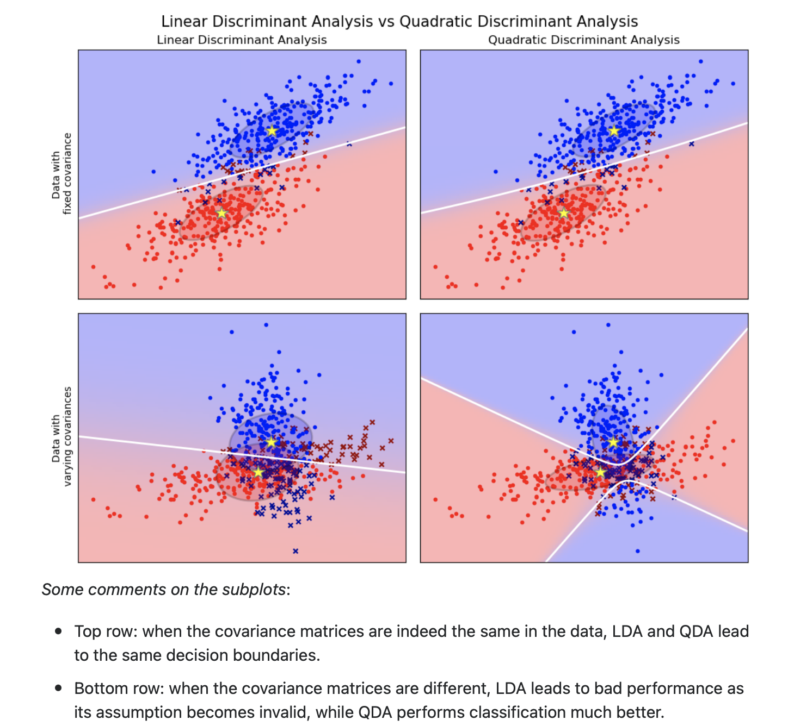
Quadratic Discriminant Analysis
Uses the same assumptions as LDA
Better option for large data sets
Higher bias and lower variance
Has a better performance when the covariance matrices are different

Slide 4
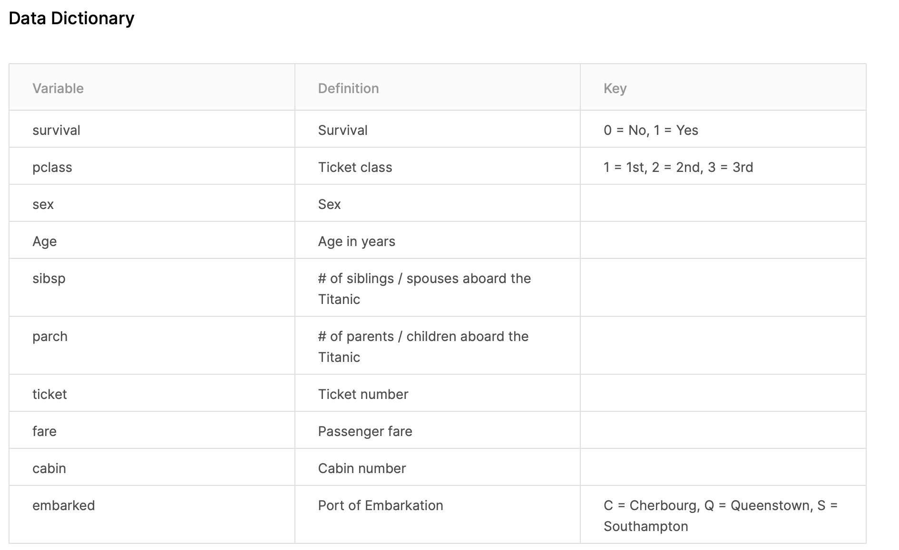
Data Source
https://www.kaggle.com/c/titanic
Data set includes a training and testing set
Goal is to predict which passengers survived the titanic shipwreck

Slide 5
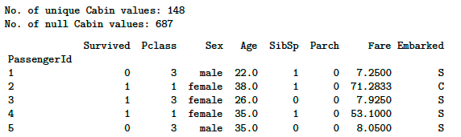
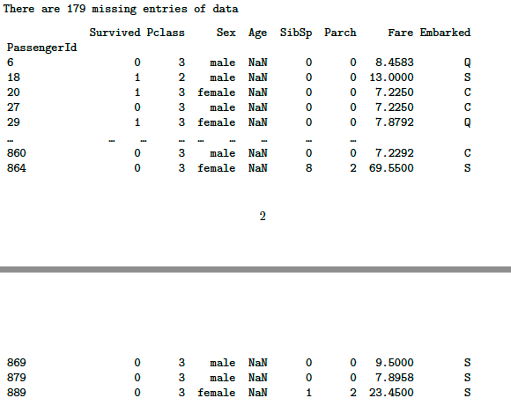
Preprocessing
A few columns (age, cabin) were missing
Filled out using data e.g., means, mode, etc.
Set categorical predictor values to binary
Sex (Male, female, other)

Slide 6
Decision Boundary Equation

Slide 7
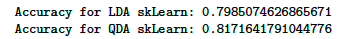
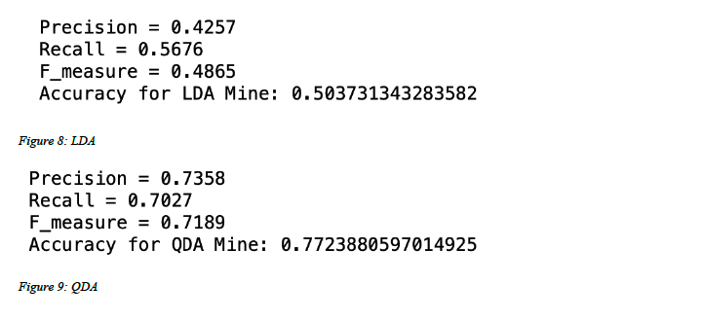
Results and Observation
QDA performed better making our initial assumptions about the data more accurate
Further exploration of results showed children and women tend to have a higher survival rate

Slide 8
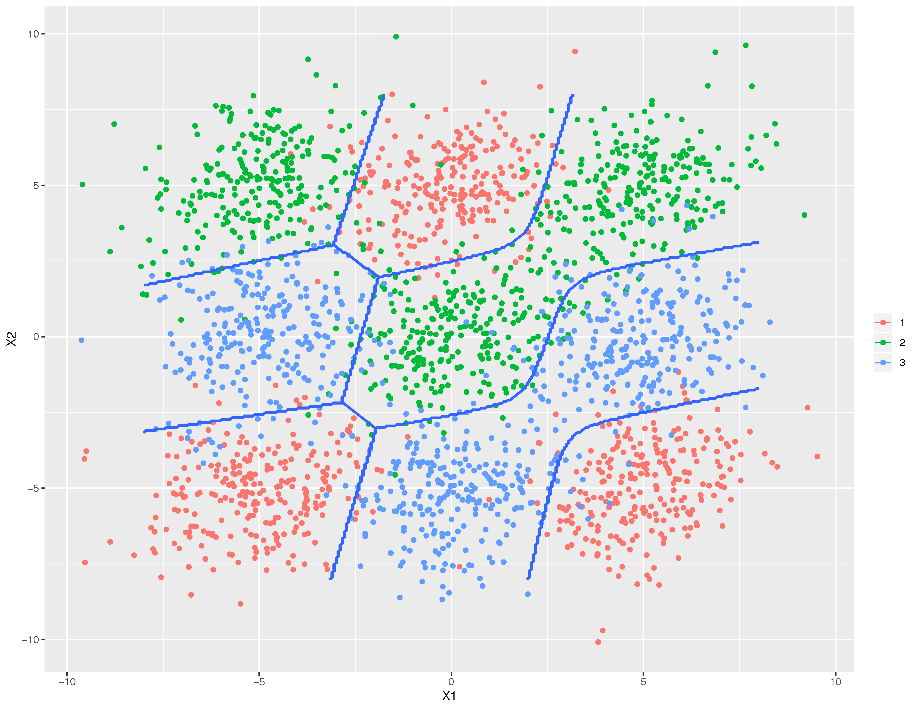
Relation to class work
A continuation of LDA
Extension of the feature extraction aspect by doing classification using naïve bayes
MDA – Continuation of LDA and QDA with its focus more than two target variables

Slide 9
Resources
https://arxiv.org/pdf/1906.02590.pdf
Julenn. (2021, May 15). Titanic. Kaggle. https://www.kaggle.com/julenn/titanic.
YouTube. (2015, September 27). Ali Ghodsi, Lec 2: Machine learning. classification, Linear and quadrtic discriminant analysis. YouTube. https://www.youtube.com/watch?v=_m7TMkzZzus.
Petrik, M. (2017, February 16). LDA, QDA, Naive Bayes. Generative Classification Models. https://marek.petrik.us/teaching/intro_ml_17/intro_ml_17_files/class5.pdf.

